Slide 1

BOOK
REVIEW

Slide 2





GROUP MEMBERS
ZIYAD AHMED ZARIF
HEMONTO
ROY
JAHID HASAN BAPPY
RAFIUL HASAN
RIDOY
SULEMAN HUSSAIN
LAJEM

Slide 3

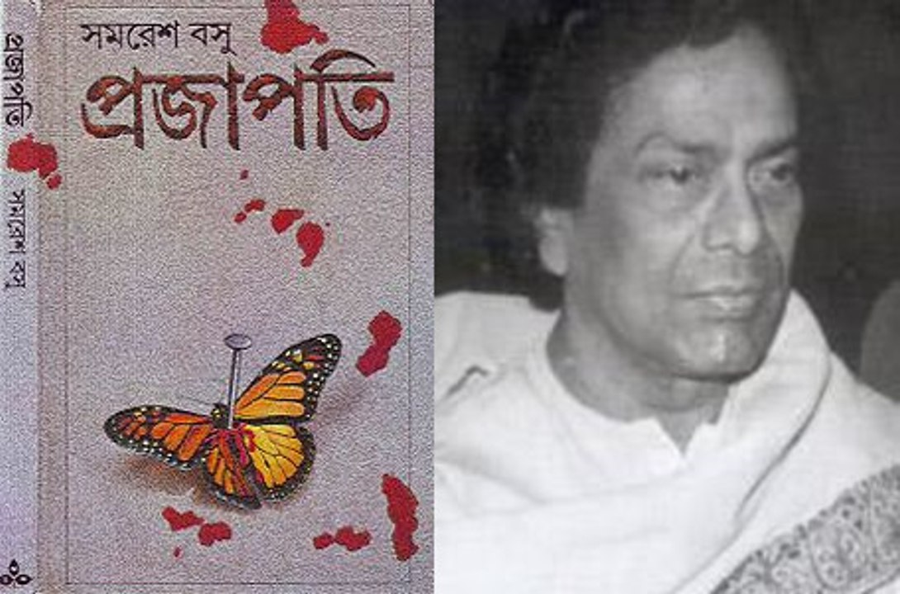
INTRODUCTION

Slide 4
Author: Samaresh Basu
Published: Puja issue of Desh, by Ananda Publishers in 1967
Time Period: Social background of the 1960s’
Significance: The novel "Prajapati" tells the story of a young man’s internal conflict and his confrontation with the uncomfortable truths of society.

Slide 5

Main Plot

Slide 6
The novel attempts to unveil the hypocrisies of society.
The main character Sukhen (Sukhendu Dey) embarks on a journey to find his sexual identity, freedom, and self-awareness. The novel depicts his struggle with the conservative values of society and family, and his experiences with love and sexuality.

Slide 7
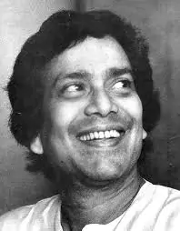
Author's Objective

Slide 8
To question the hypocrisy and conservatism of the society
To address bold topics like sexuality and freedom with courage
To portray harsh realism avoiding moral condemnation
To compel the reader to reflect “What is moral and righteous?"

Slide 9

Strengths &
Weaknesses

Slide 10
Strengths
Bold and clear language
Deep psychological analysis
Accurate depiction of social realities and sexuality
Weaknesses
The explicit language used in the novel may make some readers uncomfortable
One dimensional characterization of women, who were depicted as submissive and manipulative

Slide 11

Why was this book Banned?

Slide 12
Obscenity charges:
The explicit content led to legal charges. Both Samaresh Basu and Shitangshu Kumar Dasgupta, the publisher and printer of Desh, were said to have committed an offence punishable under Section 292 of the Indian Penal Code (IPC).
Legal Decision:
Under Section 292 of the Indian Penal Code, the book was initially banned, but later the court ruled that it was a work of literature, not obscene.

Slide 13
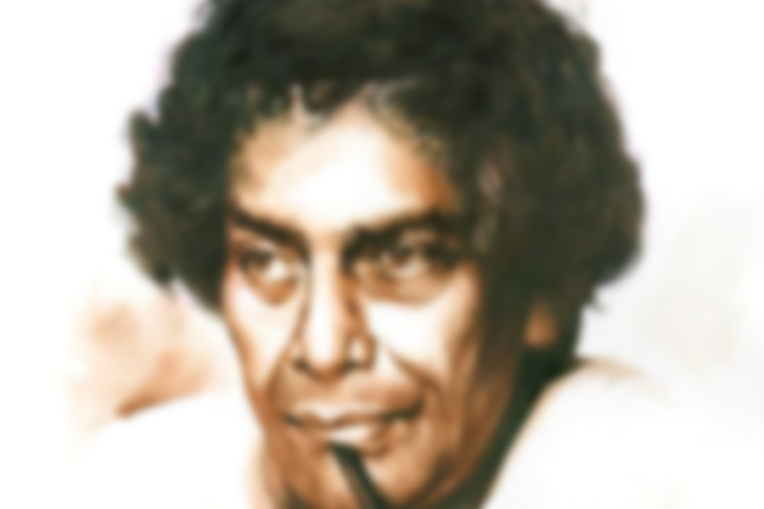


Slide 14

“Prajapati" is a courageous attempt in literature.
The relevance of the book continues to persist in today's society.
The very system it critiqued tried to silence it, only to make its voice louder.
It is a powerful example of freedom of expression and the power of independent thought in literature.

Slide 15

ANY QUESTIONS ABOUT ‘PROJAPOTI’?

Slide 16


